Slide 1
Exploratory data analysis ON King County Property Sales

Slide 2
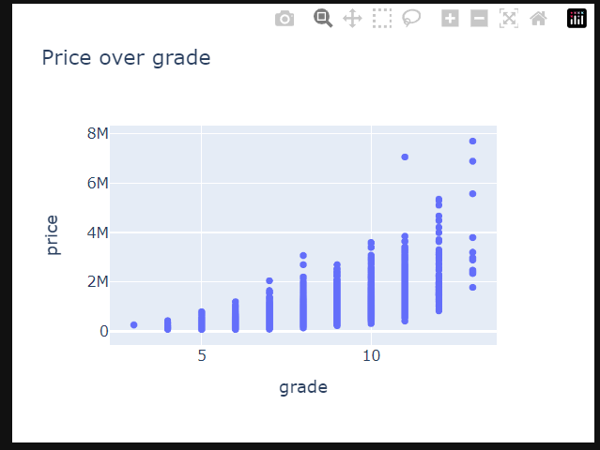
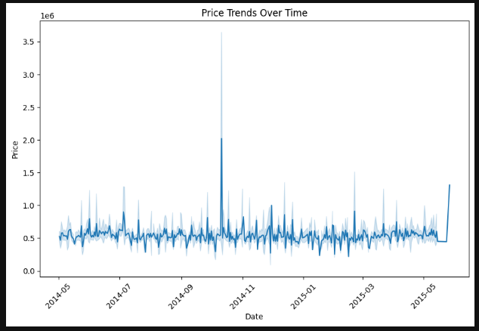
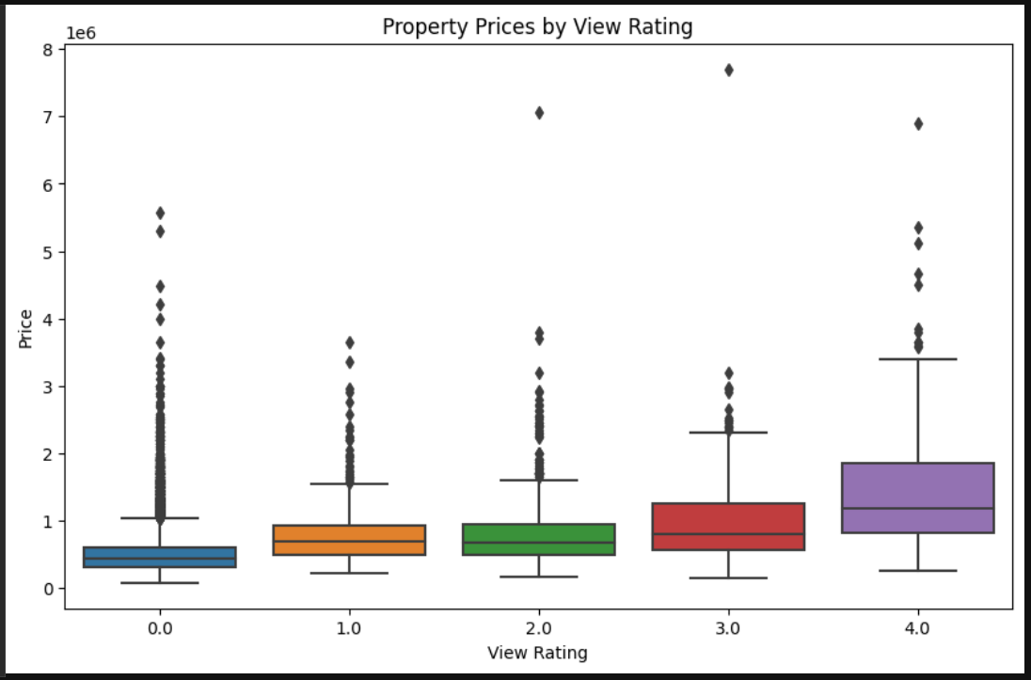
Insights
Grade influences Price positively
2. Most valued sale is in Oct 2014
3. Positive relationship between views and graph

Slide 3
King County Property Sales-Client: Nicole Johnson
Client Name: Nicole Johnson Role: Buyer
Requirements:
→ Neighborhood Preference: Central
→ Price Range: Middle Range
→ Timing: Within 1 year
Nicole's requirements are centered around finding a property in a lively and central neighborhood that fits her budget and aligns with her timeline for purchase. These criteria will guide the property search to ensure her needs and preferences are met.
Hypothesis: Since the time period is 1 year and since the client is ready to pay the middle range, it will be easy to find an apartment for the client

Slide 4
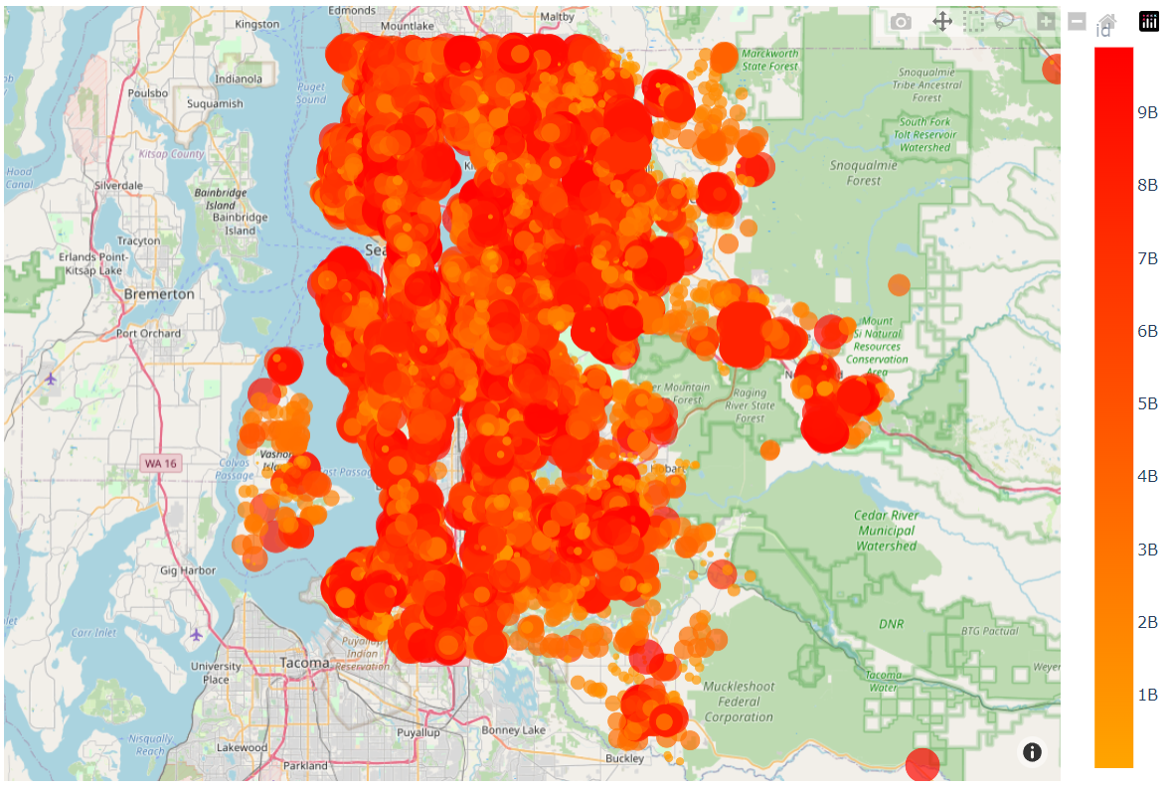
Plotting property data to
Geographical Map

Slide 5
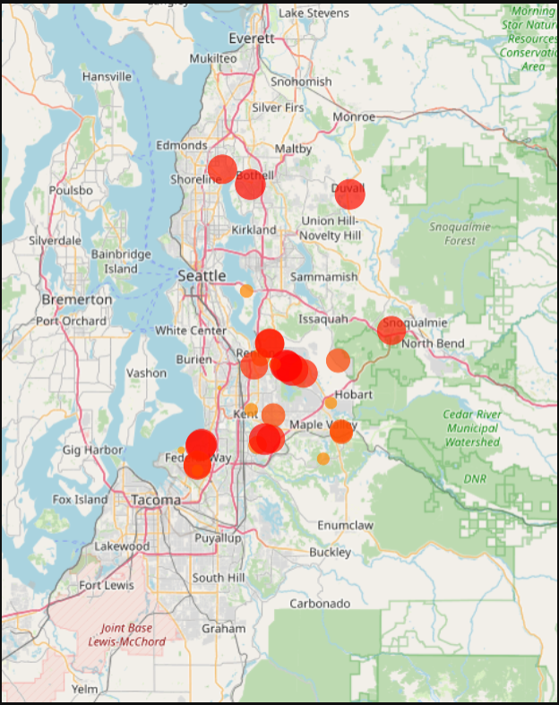
Filtering on the basis of client’s requirements:
Central location: Central location is at coordinates: 47.560197, -122.213784
(used Haversine formula)
Price: Midrange, considering 500000 to 600000
lively neighborhood as houses that are graded 10 or more with above 3
Bedrooms.
Client like to buy within a year: Assumes today as 02-11-2014

Slide 6
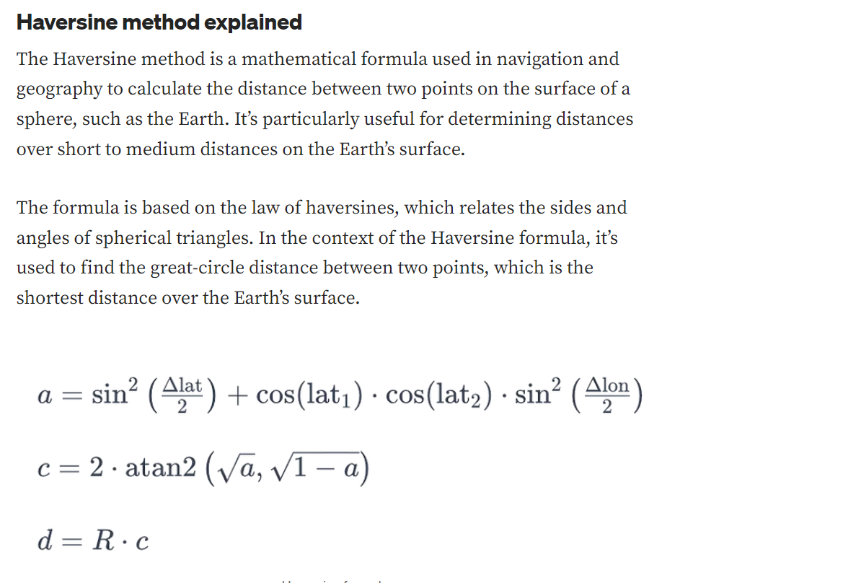

Slide 7
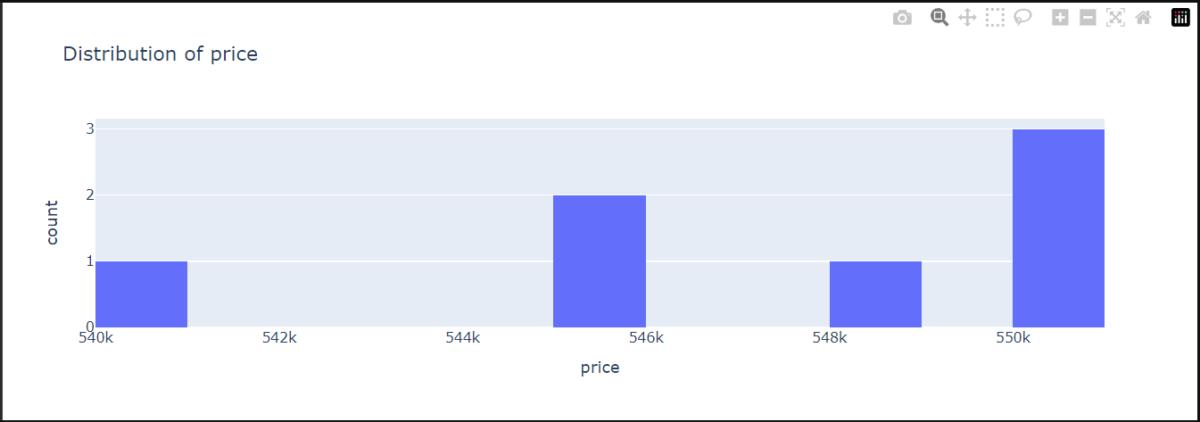
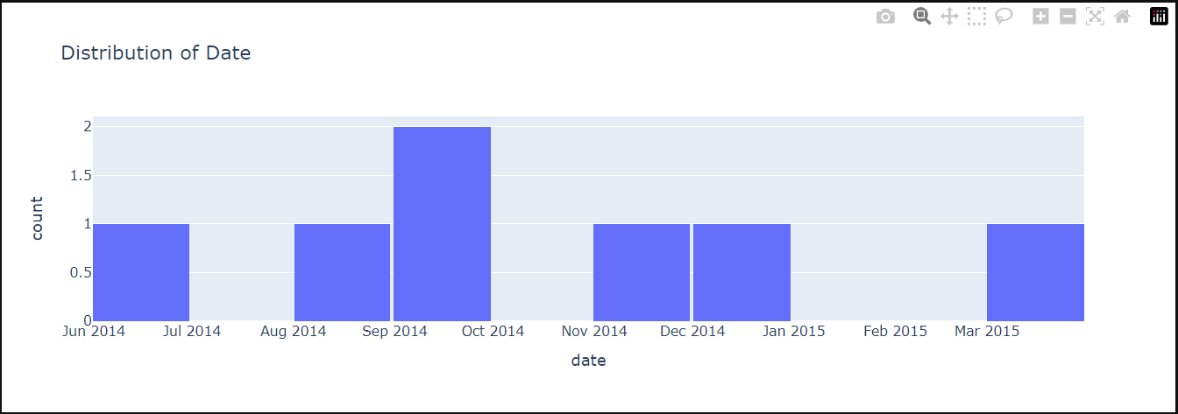
Distribution of price and date
Price:
Date:

Slide 8
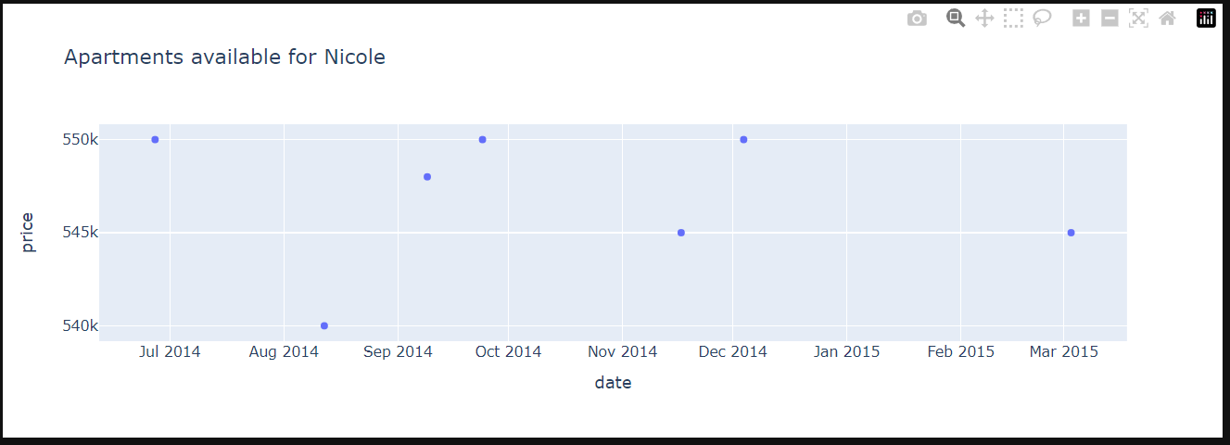
Based on the requirements and the provided data, Nicole Johnson can
buy from the list of 7 plotted apartments, and the best time to buy(Options):
1. 04/12/2014
2. 03/03/2015
3. 27/06/2014
4. 12/08/2014
5. 09/09/2014
6. 24/09/2014
7. 17/11/2014

Slide 9
